Slide 1
UiPath Integration Services with ServiceNow
Delhi Chapter

Slide 2
Agenda
Introduction to UiPath’s Integration Service.
Demo 1 – Service Now Activities
Create a new ticket
Fetch open tickets
Creation of a generic reporting module.
Demo 2 – ServiceNow Integration Service.

Slide 3
Introducing UiPath’s Integration Service

Slide 4
UiPath Integration Service
Connectors to various services.
Enables faster integration at scale.
Simplified Authentication
Connection reusability

Slide 5
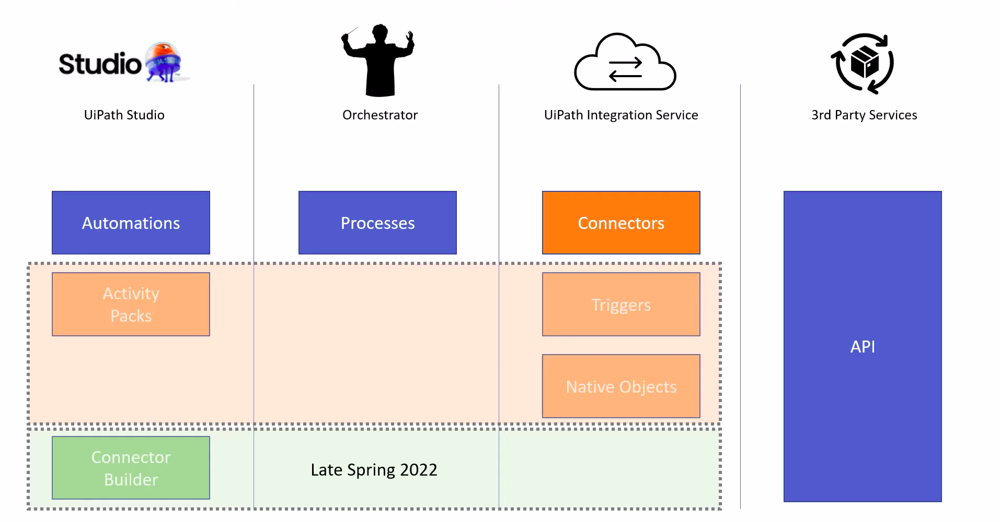

Slide 6
Service Now Integration

Slide 7
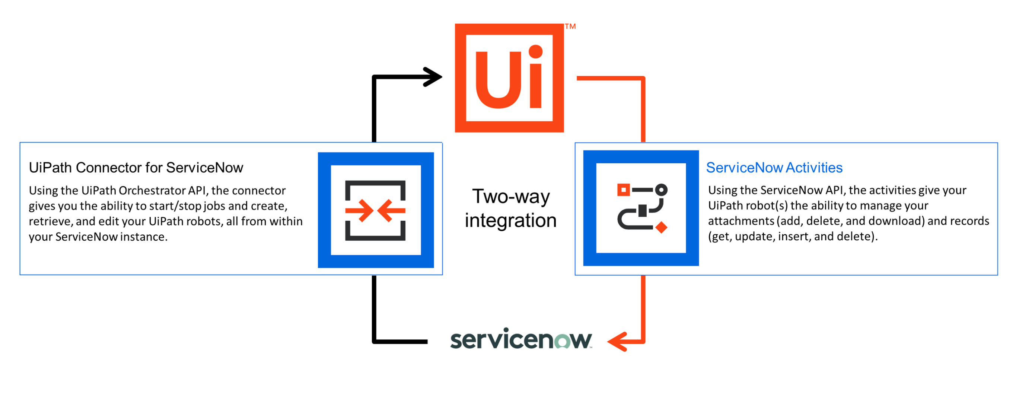

Slide 8
Demo 1 : Service Now Activities

Slide 9
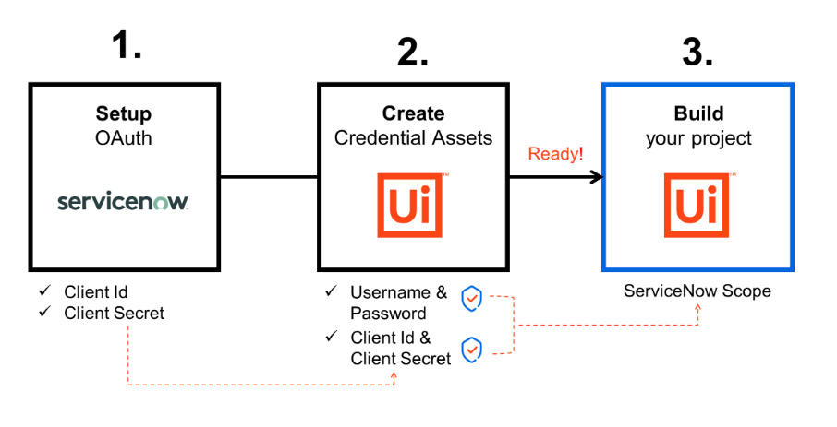

Slide 10
Demo 2 : ServiceNow Integration

Slide 11


Slide 12


